Slide 1

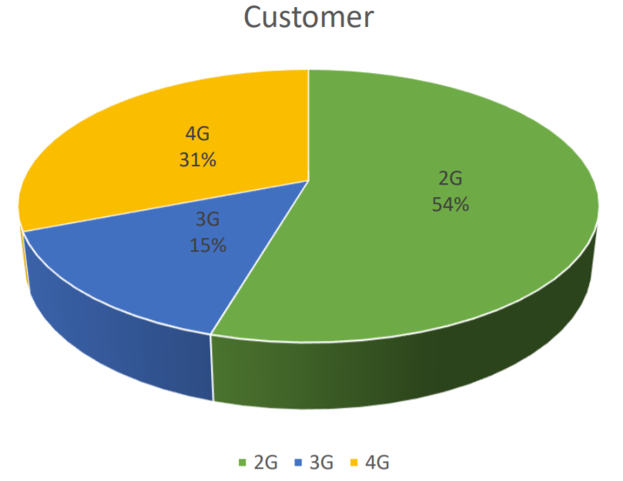
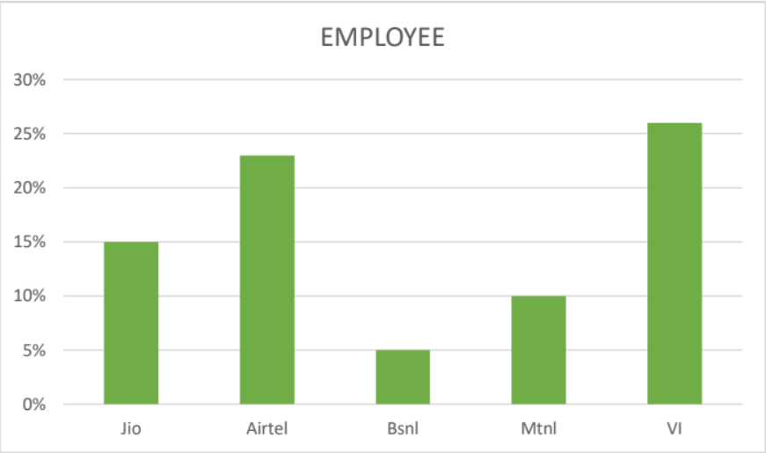
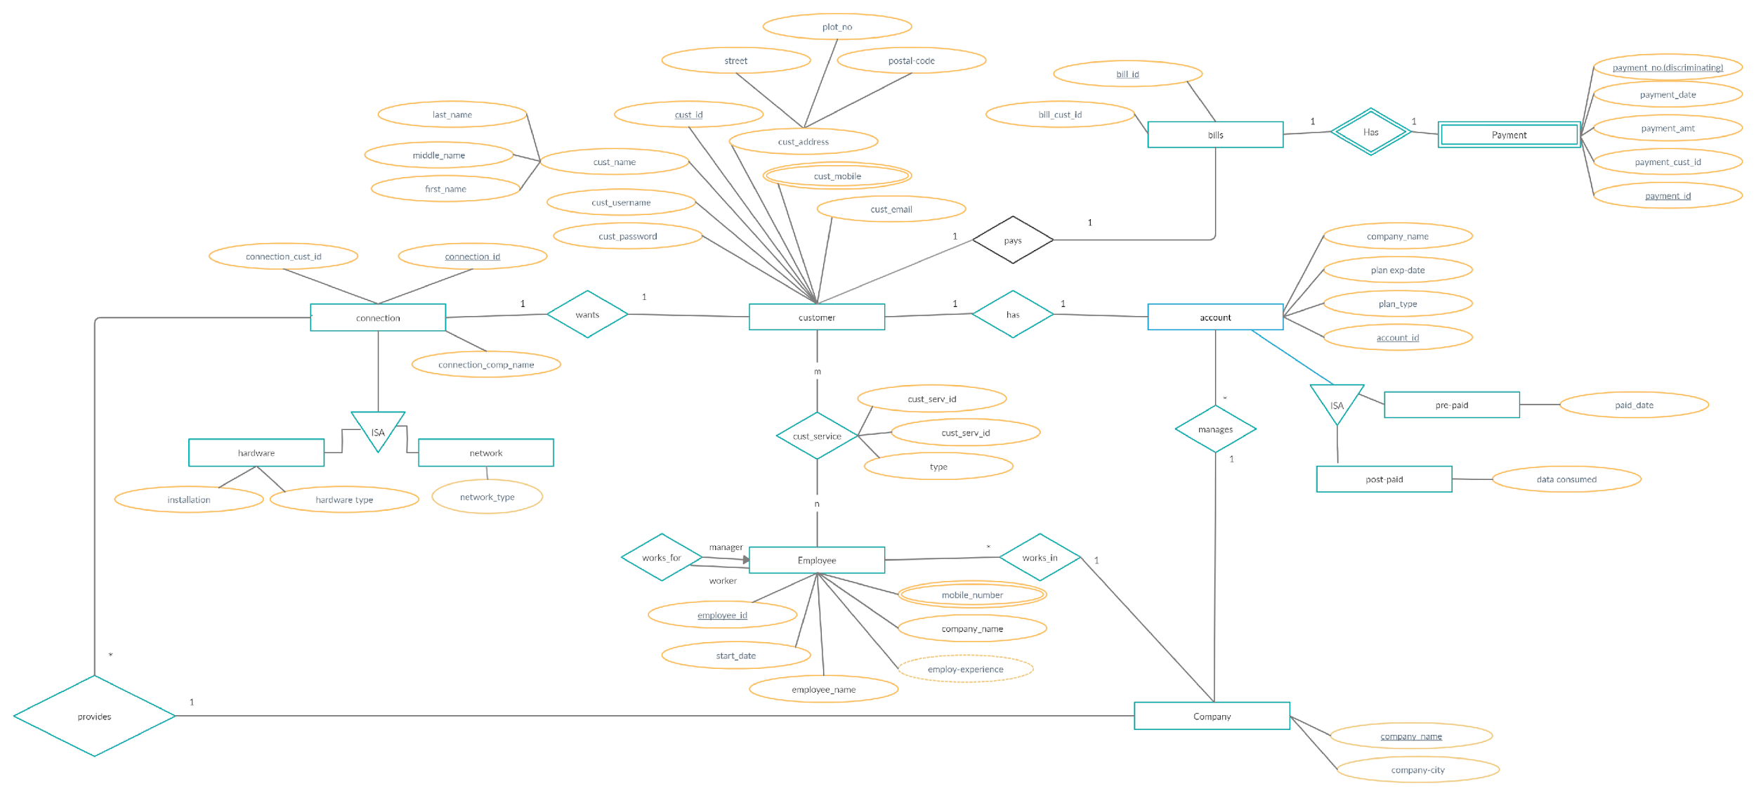
Telecommunication Management System
Shweta Chavan, Aartee Chimate, Sachin Bagoriya
Sardar Patel Institute of Technology
Abstract
Objectives
Technologies Used
The development of a telecommunication management system is needed that can satisfy the ever-changing customer requirements is increasingly needed. The system should be flexible, scalable and have the ability of adapting to these changes.It should be user friendly and be able to cope up with customers needs and requirements.
•Customer can pay bills.
•Customers can choose the connection as per their need.
•Customers can seek any technological or discount related information from the Employee of the company
•Customer can get to know there account details any-time.
Back-end: MySQL
Results
Motivation
As far as the current scenario of telecom companies, customers face many problems due to inappropriate updation of database. Thus the motivation behind this project is that Telecom companies can use automated order management systems to capture and validate data, authorize payments, automate billing, and communicate with customers more effectively and hence ultimately aim to the satisfaction of customers.
Project Scope
The telecommunication management system facilities the customer to pay bills, choose the connection as per their requirement and seek help or enquire about new offers or plans from the employee of the company.
Problem Statement
•Customers were having difficulty activating or upgrading board band service .
•Inferencing Customer Interests to there packs Or services
•To Facilitate the Customer to view and pay the bills.
Outcome
Reducing the manual work significantly and saving the time of customers.
Providing easy access to all the facilities provided by the company to the customers.

